Slide 1
Using BERT and GPT-2 to classify Explanations of Movie Recommendations as Good or Bad
Presenter: Joseph May
Date: 12/4

Slide 2



Background: Conversational Recommender Systems
Chatbots Recommender system Large Language Models
CRS

Slide 3
Search Vs. CRS
Search
CRS
Keywords
Single Interaction
Specific
Natural Language
Multi-round
Exploratory
Feedback
Context window

Slide 4
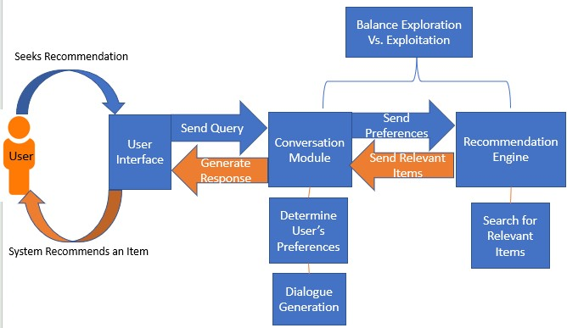
CRS: How Do They work?

Slide 5
What Makes A Good recommendation?
Factors of Explainability | Definition
Relevance | If the recommendation is relevant to the query
Length | How long the explanation is
Readability | How easy the recommendation is to read
Word Importance | The importance of words in the recommendation
Repetition | How many duplicate segments are in a sentence
Subjectivity | If the recommendation includes personal opinions and emotion
Polarity | Confidence level that the recommendation is positive or negative
Grammatical Correctness | Misspelled words and incorrect usage of language
Feature Appearance | If an explanation captures item features
Quality can be subjective!
User: I'm looking for a fun movie with Samuel L. Jackson in it, or a movie with cool gadgets.
Try Captain America Winter Soldier
Try Spiral
(Saw 9)
ExpScore: Learning Metrics for Recommendation Explanation Wen et al.

Slide 6
Quality Gaps
Word Overlap
Assessment Metrics
Comedy movies are GOOD
Comedy movies are BAD
Comedy movies are
BLEU
ROGUE
METEOR
Perplexity
Deep Learning Regimes
BERT
ChatGPT
Transformers
Contrastive Learning
Word embeddings
Translation Accuracy
The cat ran fast
The animal moved hastily
The beast moved
Notes:
Word Overlap
Language / Contextual understanding
Tools / Metrics are not yet refined for evaluating recommendations in a conversational setting

Slide 7
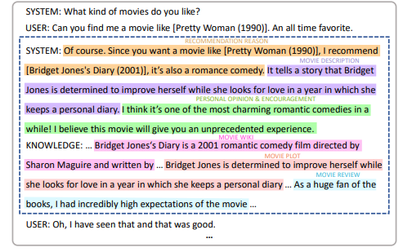
Dataset: E-Redial
Dataset Information:
Sample Conversation:
Redial Dataset ----> Extended Redial
Recorded conversations between two humans SEEKER and RECOMMENDER talking about movies
Minimum conversation length
Minimum movies mentioned
Recommendation Requirements
Movie Description (purple)
Personal Opinion (green)
Wiki Info (pink)
Plot Description (peach)
Review (cyan)
No turn order requirements
Towards Explainable Conversational Recommender Systems Guo et al.

Slide 8
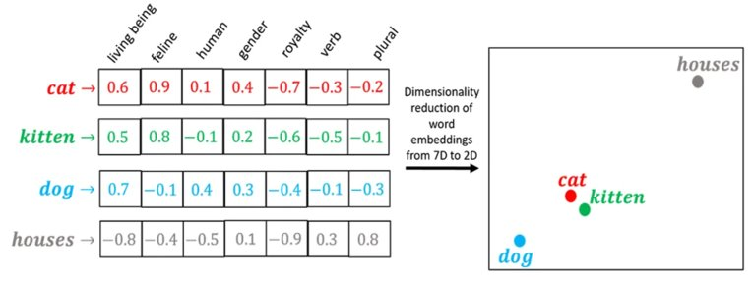
Generating Target Labels
1. Divide conversation into 2 parts
2. Use BART to summarize each half
Seeker
Recommender
Seeker Summary
Recommender Summary
3. Embed Summaries with BERT
Devlin et al. BERT: Pre-training of deep bidirectional transformers for language understanding.
Lewis et al. BART: Denoising sequence-to- sequence pre-training for natural language generation, translation, and comprehension
Embeddings Image: Word Embedding: Basics. Create a vector from a word | by Hariom Gautam | Medium

Slide 9
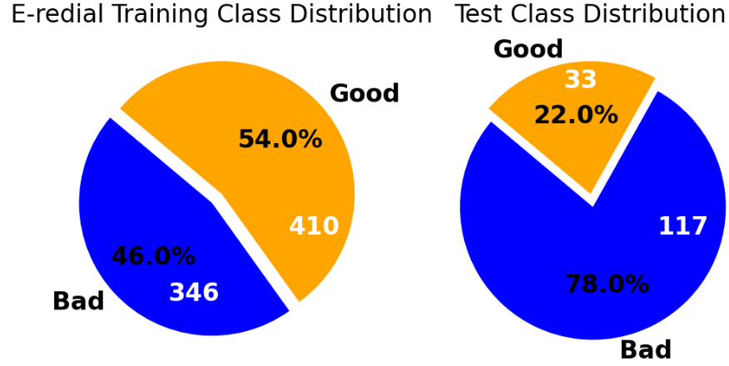
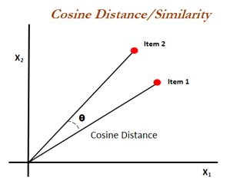
Generating Target Labels
4. Calculate Cosine Similarity of
Summary Embeddings
*
>0.88 = Good
*Imbalanced test set explicitly part of the dataset. 823 of the system responses in the test set are idle with no movie recommendations

Slide 10
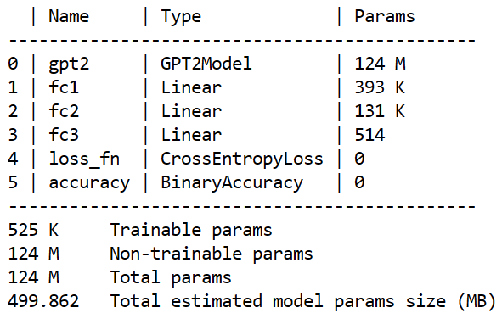
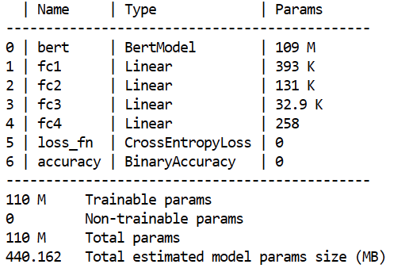
Experiment Details
GPT2
Optimizers
2. Pretrained Model
SGD
BERT-base uncased
BERT
B. Adam
B. GPT-2
60 Epochs
10 Independent Runs
C. RMSProp

Slide 11
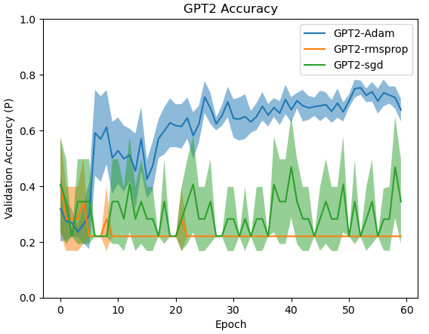
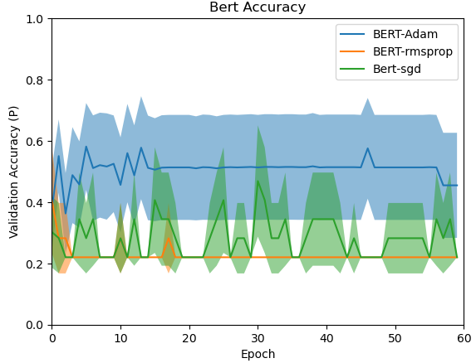
Results:

Slide 12
Summary:
Calculate the cosine similarity between seeker and recommender to generate target labels.
Examine how Adam, SGD, RMSPROP effects model accuracy
Examine how pretrained model effects model accuracy
Adam performed best overall
GPT2 performed better than BERT

Slide 13
Questions?
Thanks!

Slide 14
References
[1] Banerjee, S. and Lavie, A. METEOR: An automatic metric for MT evaluation with improved correlation with human judgments. In Goldstein, J., Lavie, A., Lin, C.-Y., and Voss, C., editors, Proceedings of the ACL Workshop on Intrinsic and Extrinsic Evaluation Measures for Machine Translation and/or Summarization, pages 65–72. Association for Computational Linguistics.
[2] Chen, X., Zhang, Y., and Wen, J.-R. Measuring ”why” in recommender systems: a comprehensive survey on the evaluation of explainable recommendation.
[3] Devlin, J., Chang, M.-W., Lee, K., and Toutanova, K. BERT: Pre-training of deep bidirectional transformers for language understanding.
[4] Fu, Z., Xian, Y., Zhang, Y., and Zhang, Y. Tutorial on Conversational Recommendation Systems. In Proceedings of the 14th ACM Conference on Recommender Systems, RecSys ’20, pages 751–753, New York, NY, USA, September 2020. Association for Computing Machinery.
[5] Gao, C., Lei, W., He, X., de Rijke, M., and Chua, T.-S. Advances and challenges in conversational recommender systems: A survey. AI Open, 2:100–126, January 2021.
[6] Guo, S., Zhang, S., Sun, W., Ren, P., Chen, Z., and Ren, Z. Towards explainable conversational recommender systems. In Proceedings of the 46th International ACM SIGIR Conference on Research and Develop- ment in Information Retrieval, pages 2786–2795.
[7] Hayati, S. A., Kang, D., Zhu, Q., Shi, W., and Yu, Z. INSPIRED: Toward Sociable Recommendation Dialog Systems. In Proceedings of the 2020 Conference on Empirical Methods in Natural Language Processing (EMNLP), pages 8142–8152, Online, November 2020. Association for Computational Linguistics.
[8] Lewis, M., Liu, Y., Goyal, N., Ghazvininejad, M., Mohamed, A., Levy, O., Stoyanov, V., and Zettlemoyer, L. BART: Denoising sequence-to- sequence pre-training for natural language generation, translation, and comprehension. In Jurafsky, D., Chai, J., Schluter, N., and Tetreault, J., editors, Proceedings of the 58th Annual Meeting of the Association for Computational Linguistics, pages 7871–7880. Association for Compu- tational Linguistics.
[9] Li, R., Kahou, S., Schulz, H., Michalski, V., Charlin, L., and Pal, C. Towards Deep Conversational Recommendations, March 2019. arXiv:1812.07617 [cs, stat].

Slide 15
References
[10] Lin, C.-Y. ROUGE: A package for automatic evaluation of summaries. In Text Summarization Branches Out, pages 74–81. Association for Computational Linguistics.
[11] Liu, C.-W., Lowe, R., Serban, I., Noseworthy, M., Charlin, L., and Pineau, J. How NOT To Evaluate Your Dialogue System: An Empir- ical Study of Unsupervised Evaluation Metrics for Dialogue Response Generation. In Proceedings of the 2016 Conference on Empirical Methods in Natural Language Processing, pages 2122–2132, Austin, Texas, November 2016. Association for Computational Linguistics.
[12] Papineni, K., Roukos, S., Ward, T., and Zhu, W.-J. BLEU: a method for automatic evaluation of machine translation. In Proceedings of the 40th Annual Meeting on Association for Computational Linguistics, ACL ’02, pages 311–318. Association for Computational Linguistics.
[13] Sezerer, E. and Tekir, S. A survey on neural word embeddings.
[14] Vaswani, A., Shazeer, N., Parmar, N., Uszkoreit, J., Jones, L., Gomez, A. N., Kaiser, L., and Polosukhin, I. Attention is all you need.
[15] Wen, B., Feng, Y., Zhang, Y., and Shah, C. ExpScore: Learning metrics for recommendation explanation. In Proceedings of the ACM Web Conference 2022, WWW ’22, pages 3740–3744. Association for Computing Machinery.
[16] Zhang, Y., Chen, X., Ai, Q., Yang, L., and Croft, W. B. Towards Conversational Search and Recommendation: System Ask, User Re- spond. In Proceedings of the 27th ACM International Conference on Information and Knowledge Management, pages 177–186, Torino Italy, October 2018. ACM

